Slide 1

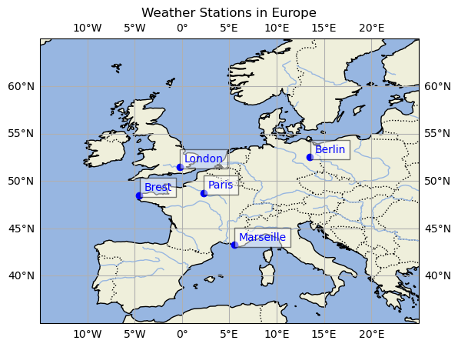
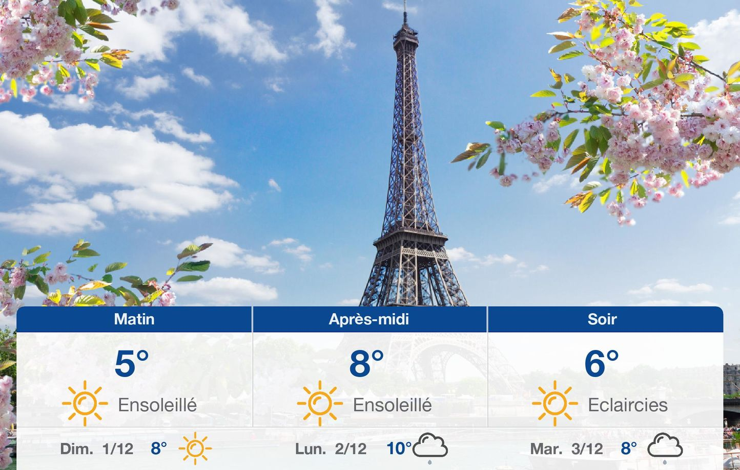
ML for climate and Energy (MEC51057)
Weather station 2024-2025
Mentor: Julio Cardenas
Students: Dimitri Iratchet - Fabien Lagnieu - Tristan Waddington

Slide 2
ML for climate and Energy (MEC51057)
I. Project presentation
1.1 General presentation
Aim of the project :
Paris weather station was cyber-hacked !
It is therefore unable to share its weather measures since the beginning of 2019.
Our task is to predict this missing data from other European weather stations measures.

Slide 3
ML for climate and Energy (MEC51057)
Raw files
Raw measurements in xarray
DataFrame
df per city
data exploration
Red + norm
13 years
Normalized per feature
Hourly
10 features each
1980-2019
Shift +3
Split in train / test / val
Add 3 previous days on the same row
Reduced to daily sample
X_train: 3287x160
X_train: 3287x40
easy plotting
5 stations
17M points
I. Project presentation
1.2 Data presentation

Slide 4
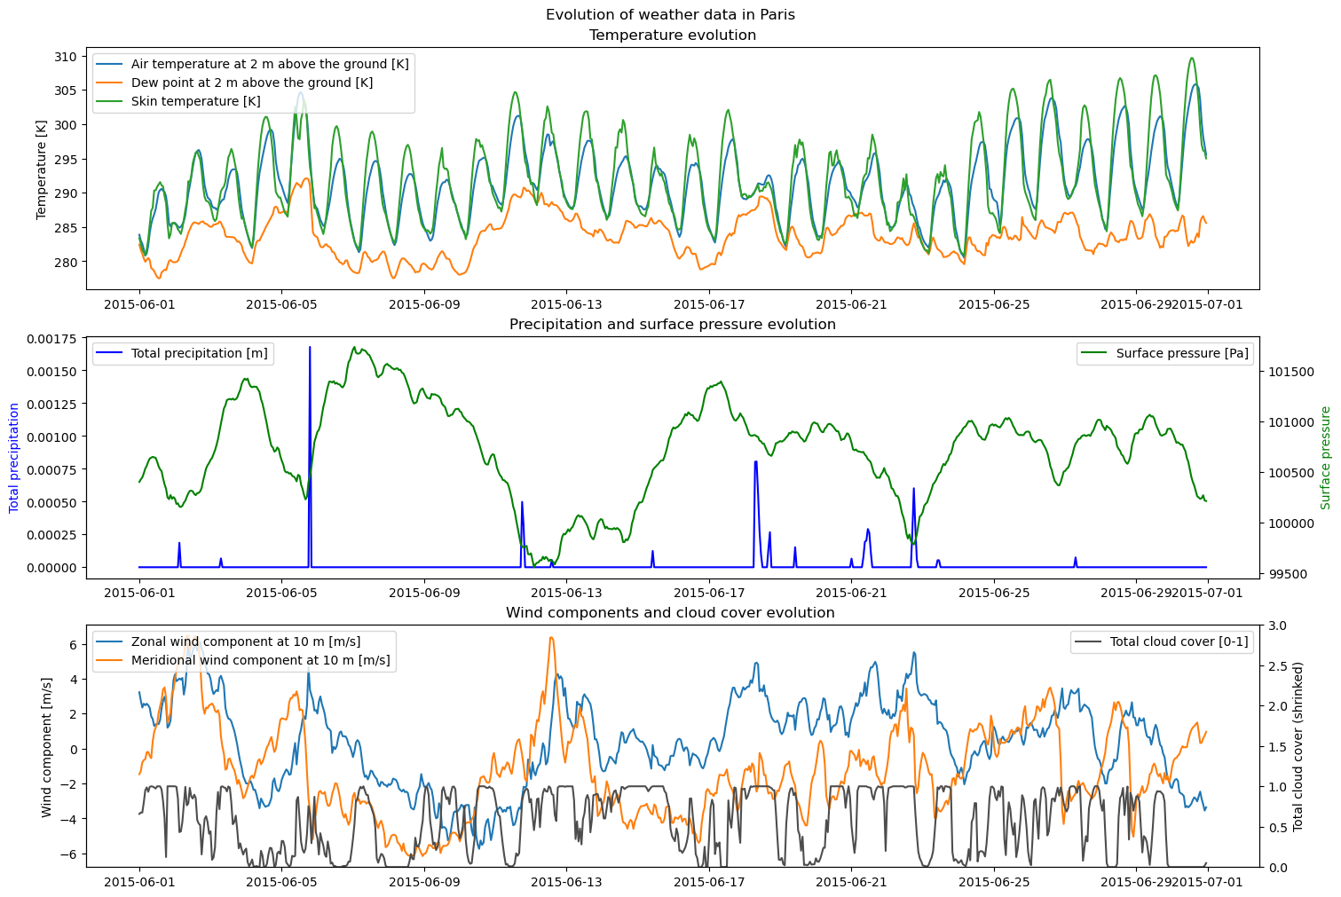
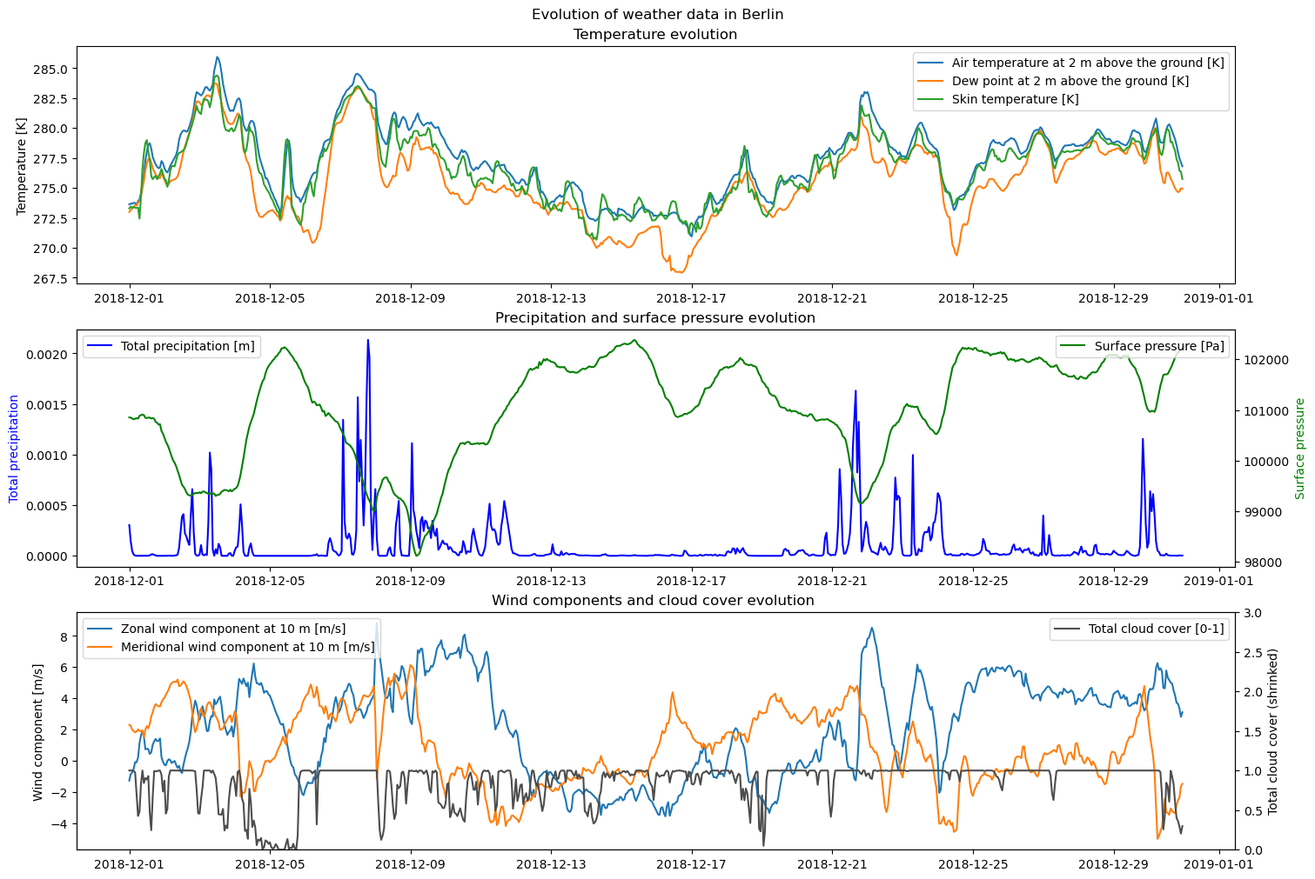
ML for climate and Energy (MEC51057)
II. Data Loading / preparation / study
2.1 Data exploration

Slide 5
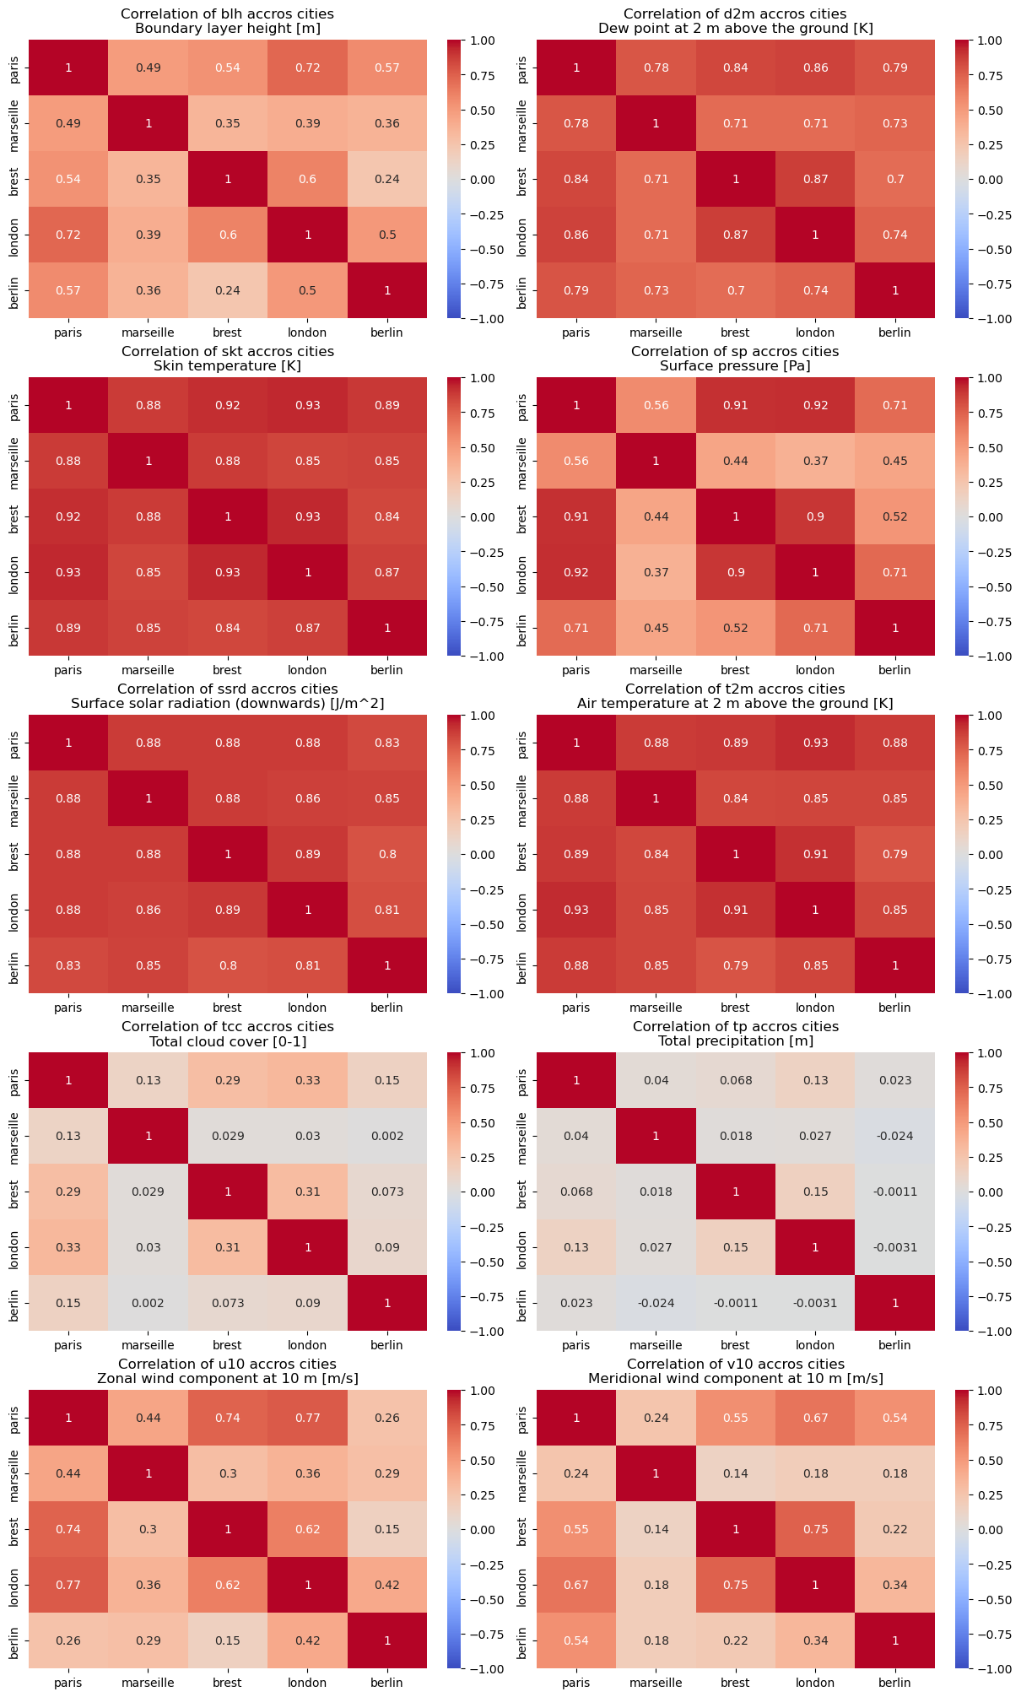
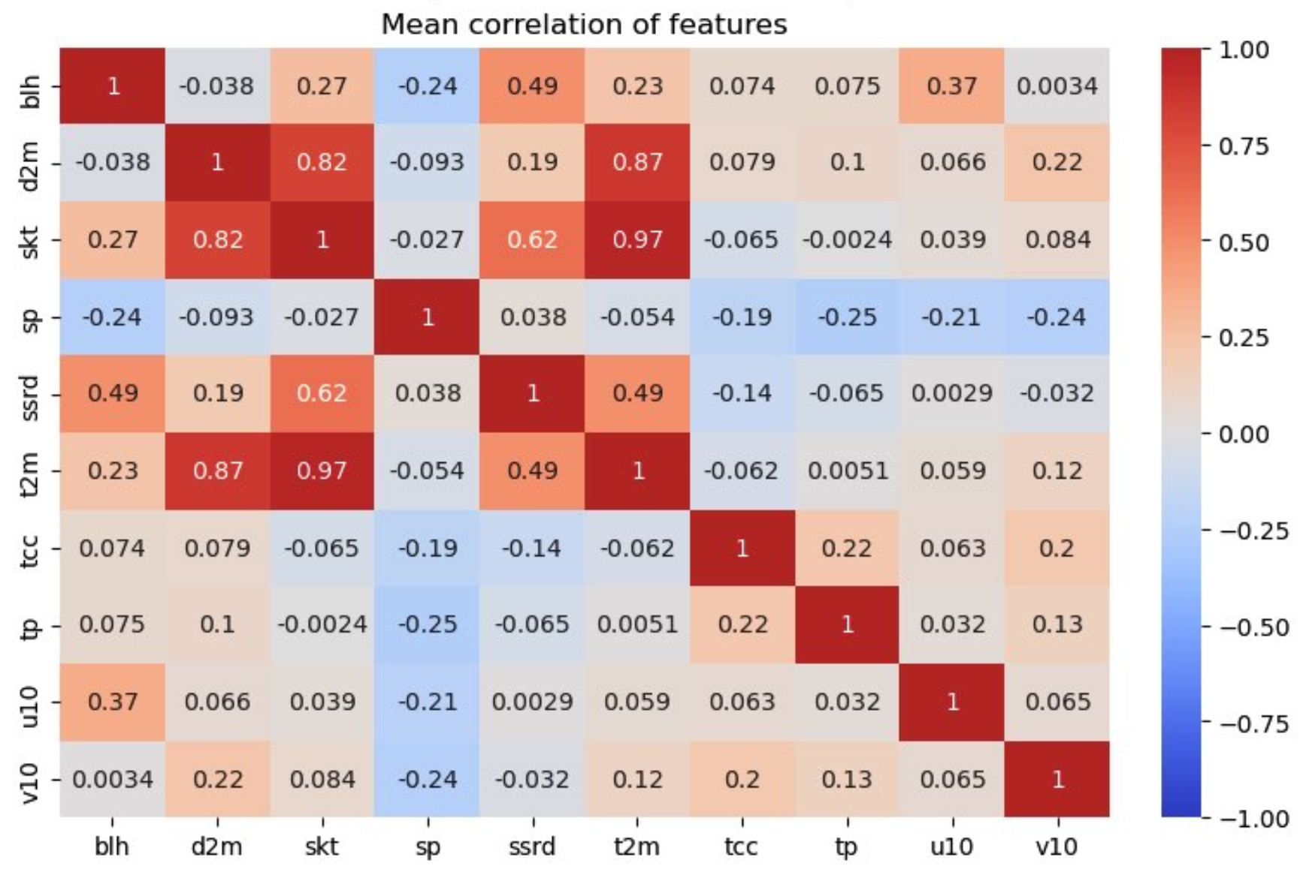
ML for climate and Energy (MEC51057)
II. Data Loading / preparation / study
2.2 Covariance study
—> Between Features
—> Between Cities

Slide 6
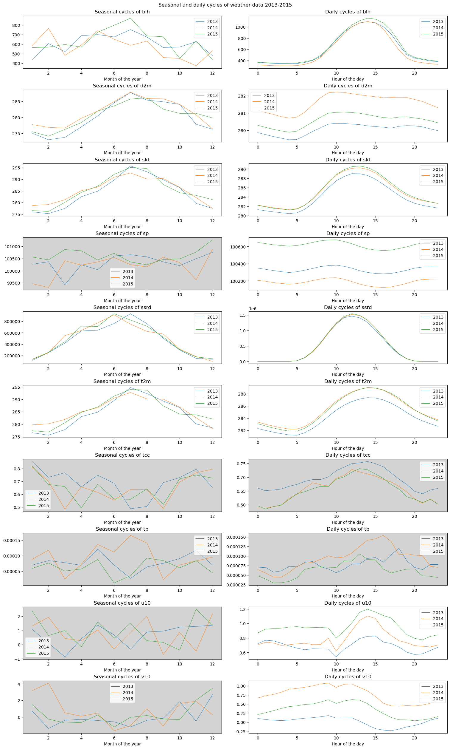
ML for climate and Energy (MEC51057)
II. Data Loading / preparation / study
2.3 Cycles in features

Slide 7
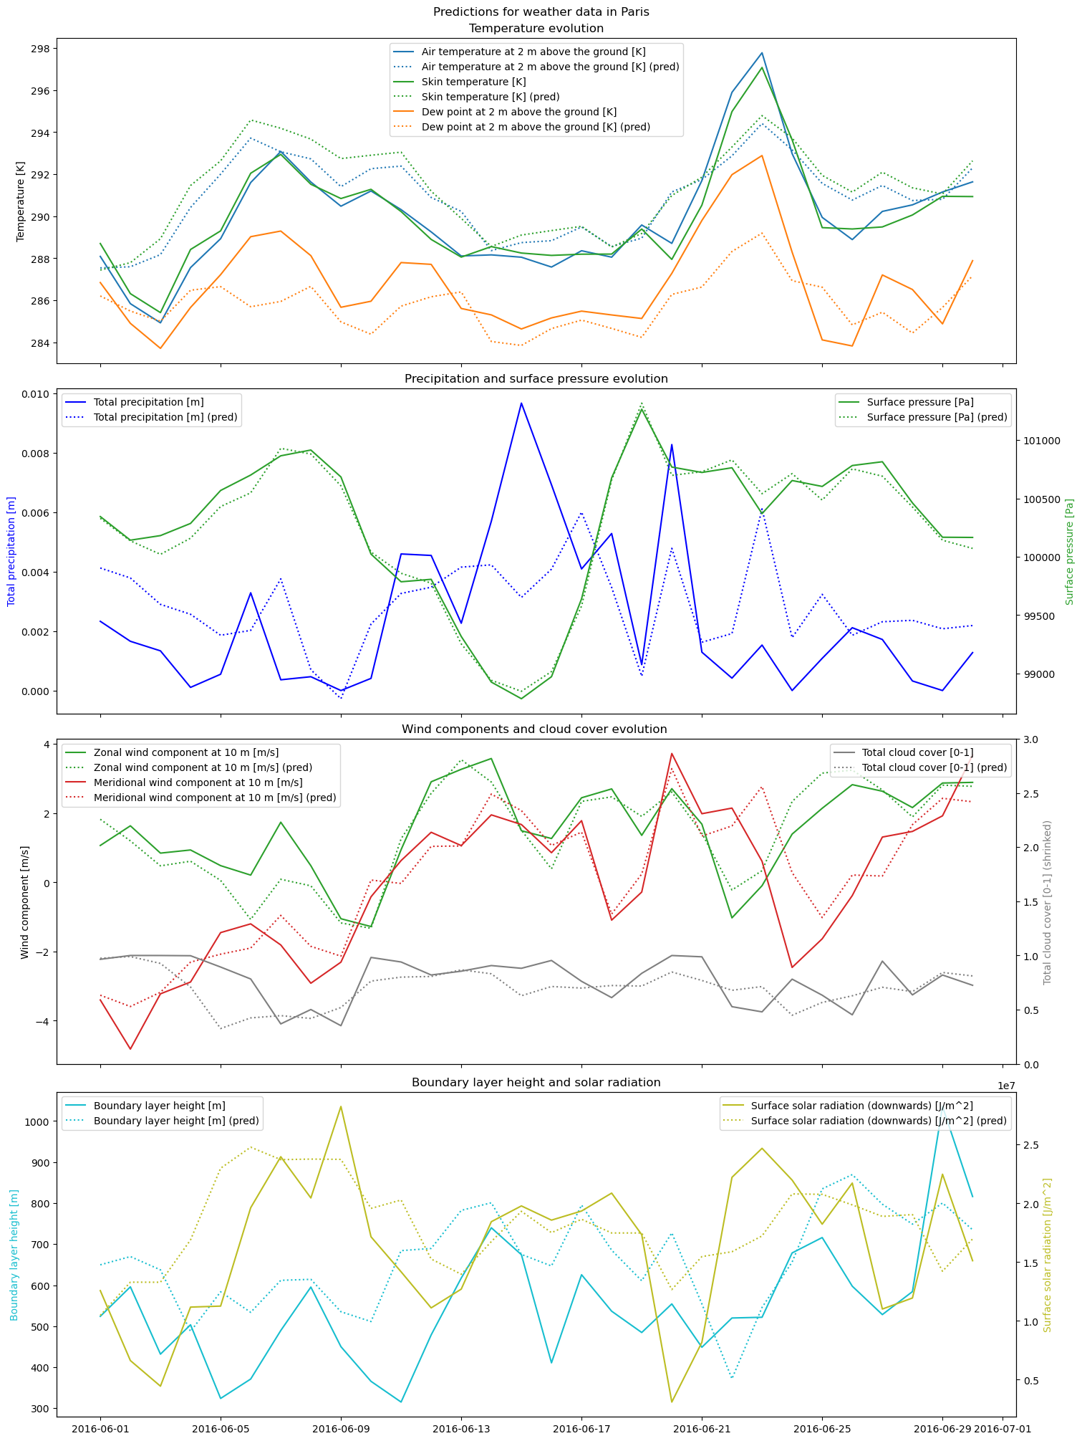
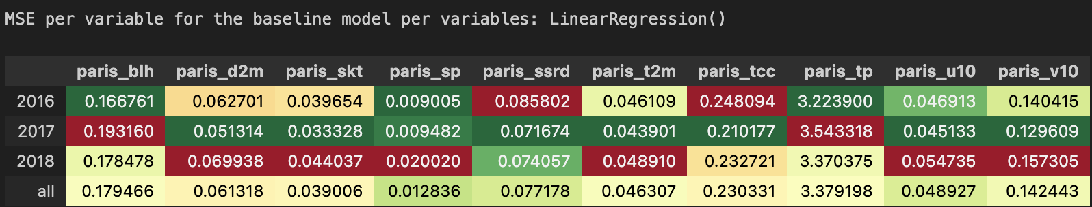
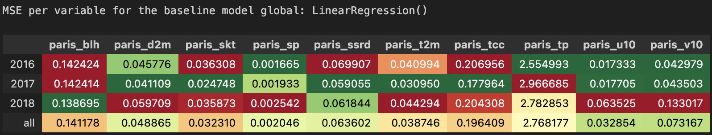
ML for climate and Energy (MEC51057)
III. Prediction of Paris Weather
3.0 Baseline : Linear regressor
Do we have different result when focusing only on one feature or are we more accurate when using all available features of the dataset?
In the following colored-gradients, we are expecting to have the most dark green / low value cells.

Slide 8
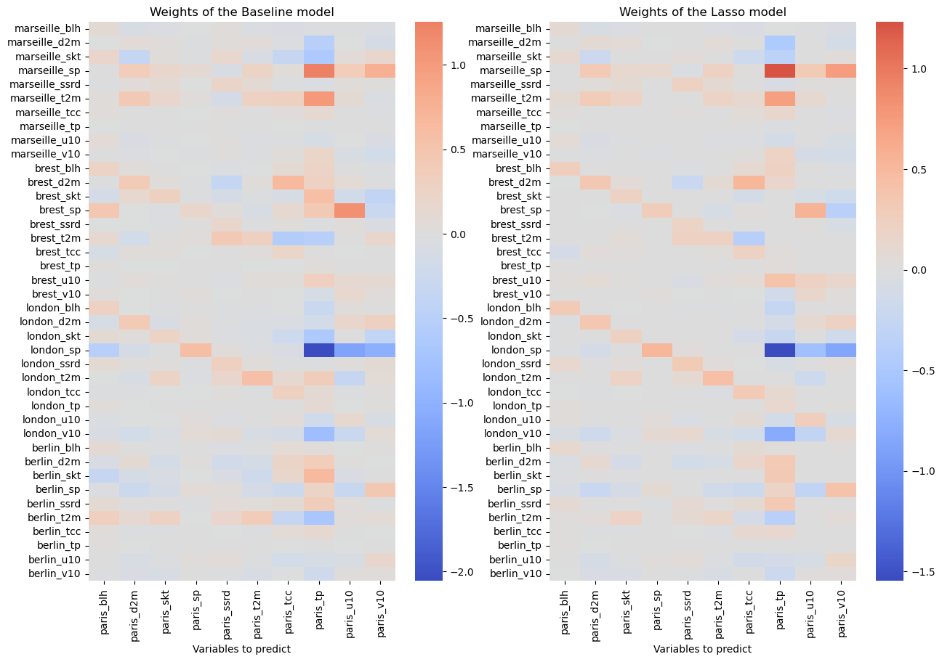
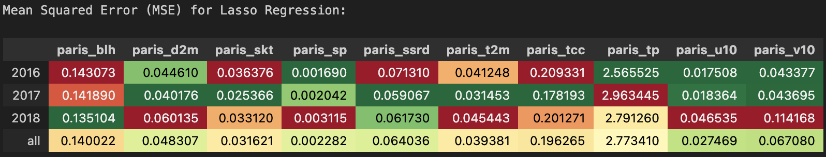
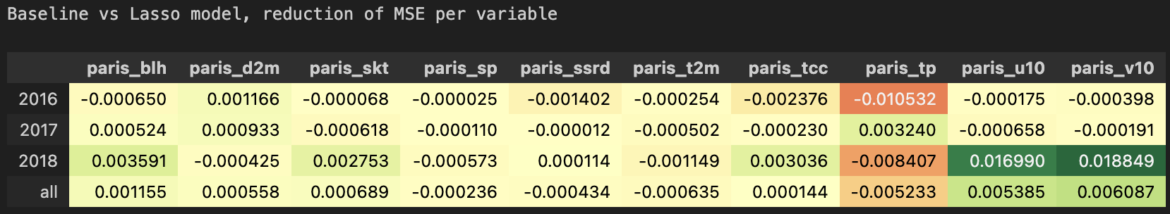
ML for climate and Energy (MEC51057)
III. Prediction of Paris Weather
3.1 Testing models
Linear Lasso

Slide 9
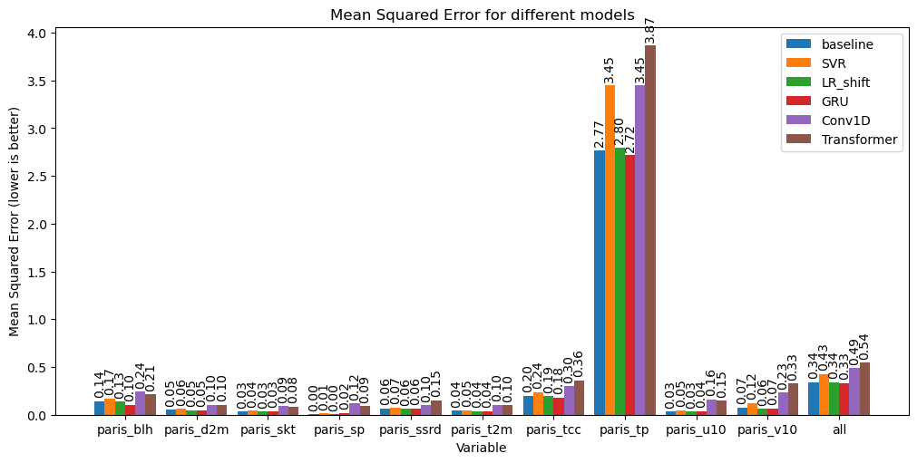
ML for climate and Energy (MEC51057)
III. Prediction of Paris Weather
3.1 Testing models
Tree-based models :
RandomForestRegressor
XGBoost
SVR
Deep learning :
GRU
CONV1D
Transformer

Slide 10
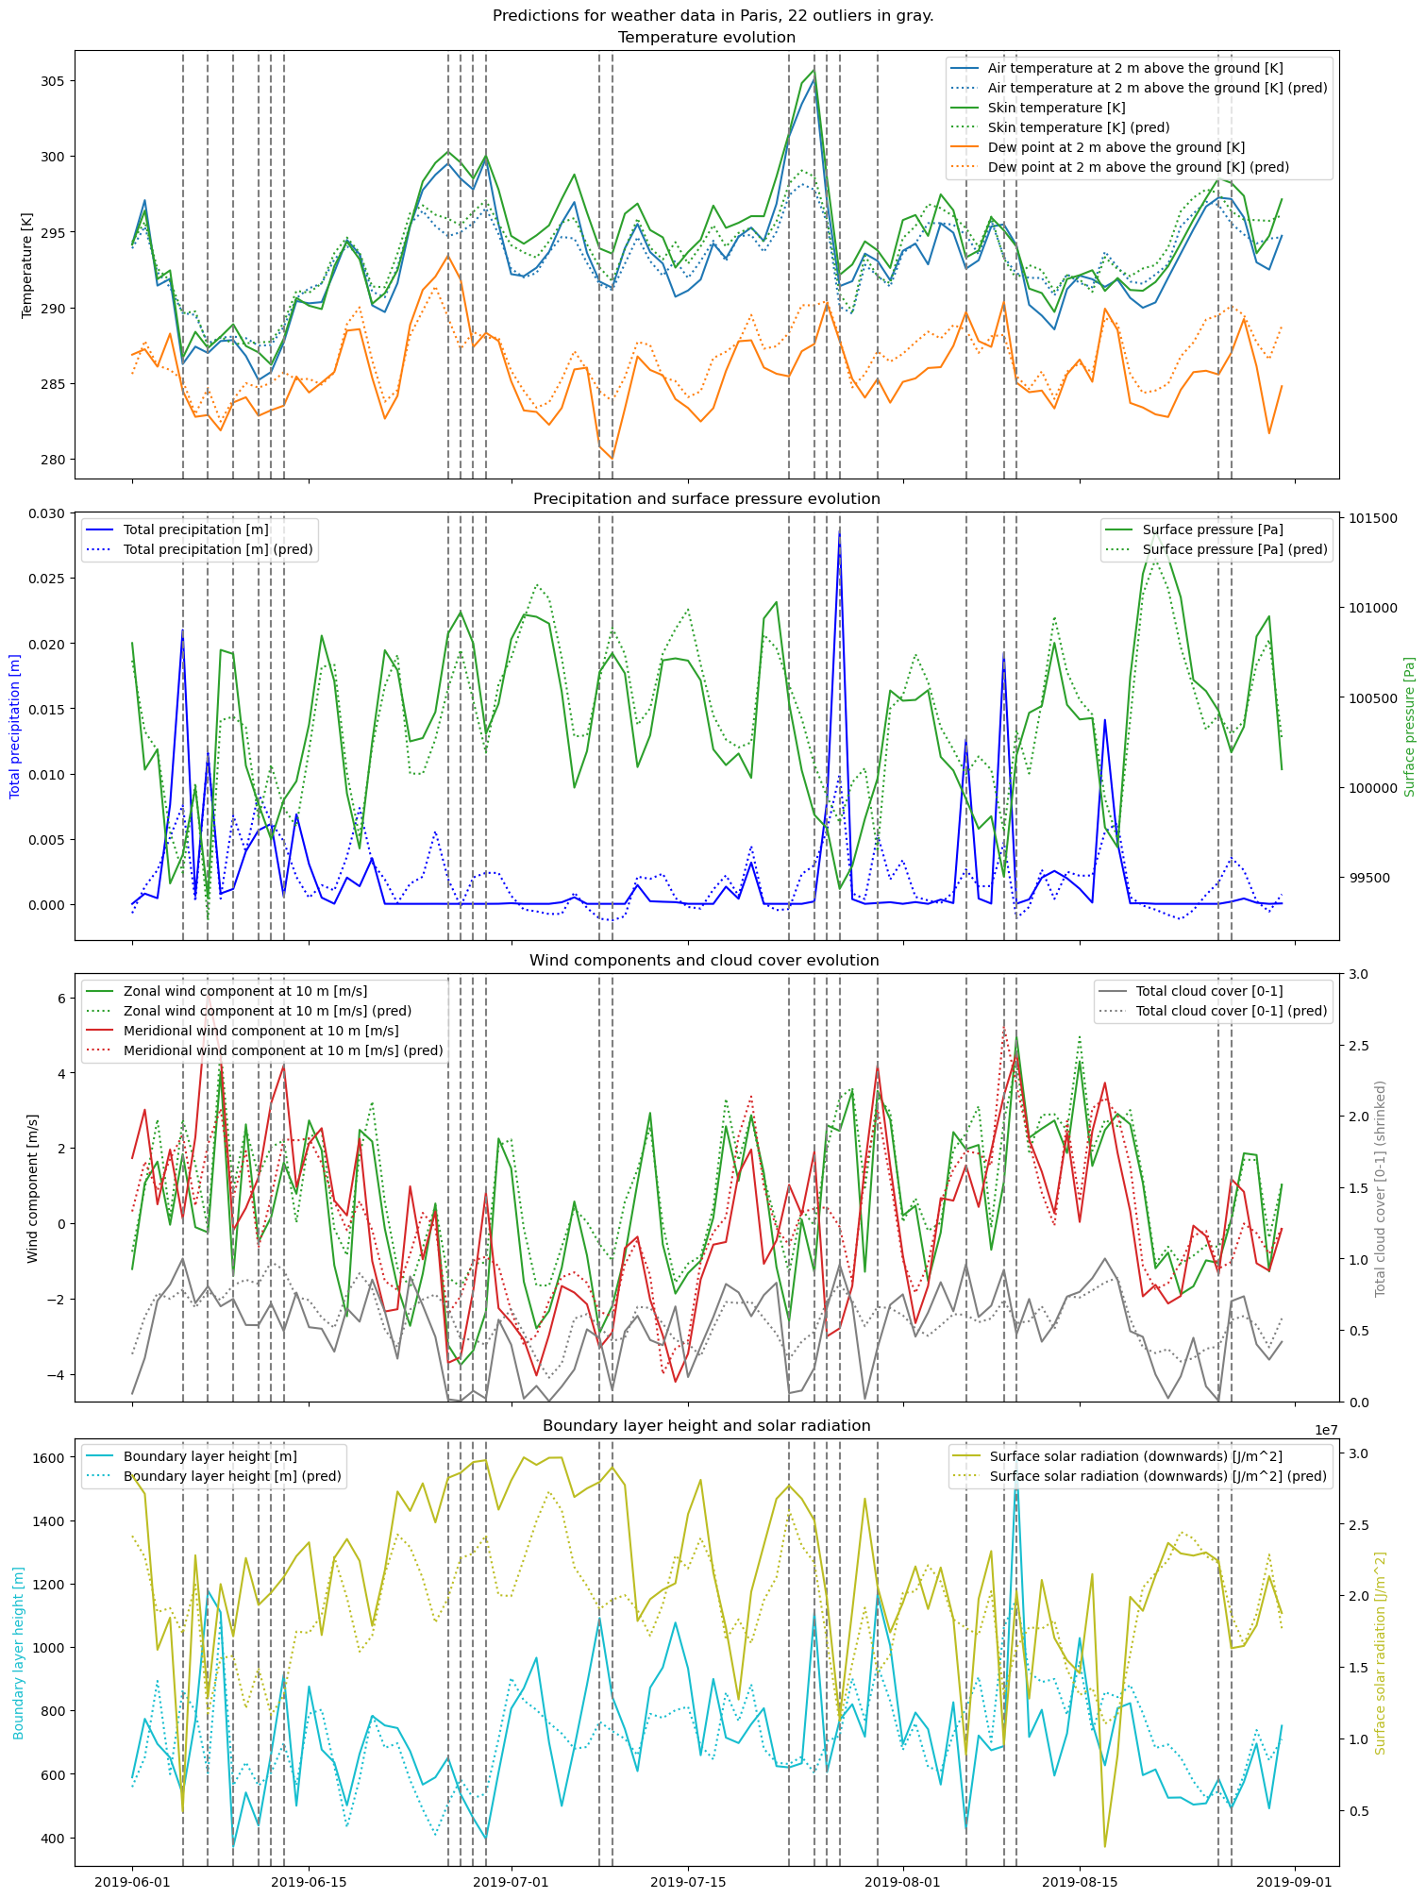
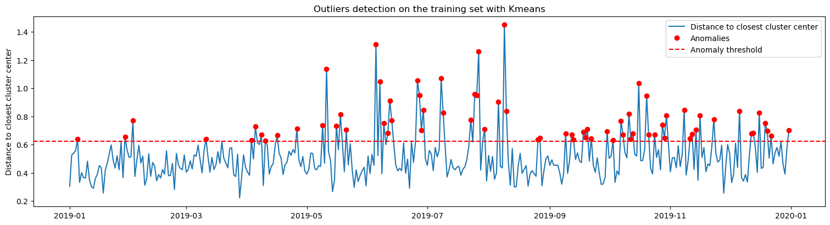
ML for climate and Energy (MEC51057)
IV. Anomaly Detection
Asumption 2016-2018: 1 cyber-incident / year with Paris reports
Detect anomalies between predictions and reports:
Best predictor= average of the 3 best models
With Kmeans --> 72 anomalies in 2019
With IsolationForest --> 1 anomaly in 2019
But represent extrema in weather reports ==> no cyber hack.

Slide 11
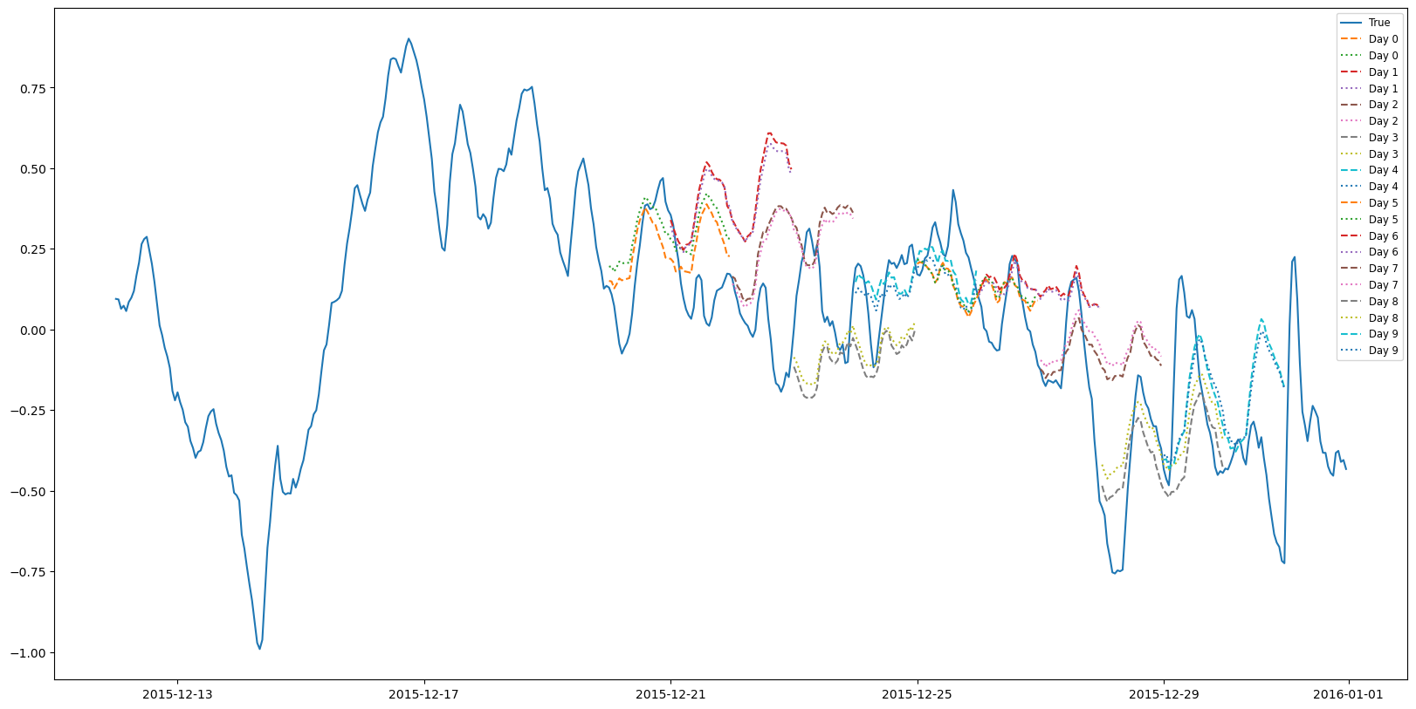
ML for climate and Energy (MEC51057)
Conclusion
Ambitious project: Supervised Regression + Unsupervised Classification
==> we did it !
To go further :
times series with hourly data
simulate a datastream with modified data

